Slide 1
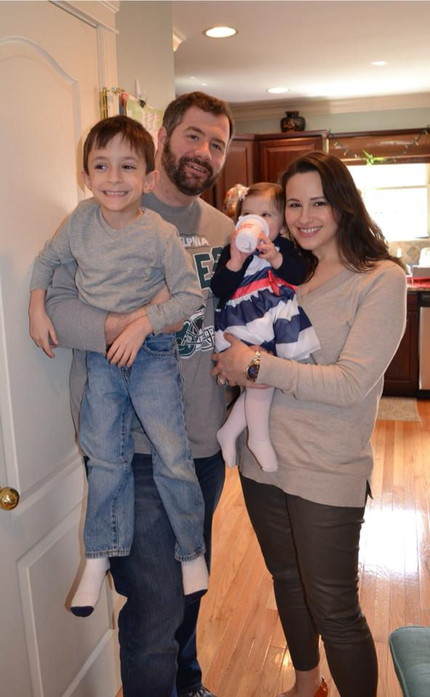
Meet Ted Mucellin
Lives with wife and our soon-to-be-born daughter in Philly
Attorney for 9 years
Worked in political campaigns, government relations consulting
Entered Real Estate to leverage these contacts – worked for almost 2 years doing business development for Keller Williams Center City ownership.
Became “Team Leader”/CEO of Keller Williams Center City, and eventually a shareholder, for almost 3 years.

Slide 2
A Brief History of Real Estate Models
According to Ted…
Keller
Williams
Traditional
Weichert
ReMax
High Splits
Top Down Structure
Hands on at Premium Cost
Reliance on “500 lb Gorilla” Brand
Competitive Splits
Top Down Structure
Hands on Help and Top Notch Training
Focused tools and system.
Company lead generation
Medium Splits with max paid (cap)
Low monthly fees tied to expenses
Focus on providing tools, training and models “buffet style” for agents
Low or No Splits
High Monthly Fees
“Rent-a-brokerage” approach.
Little or no training or tools

Slide 3
The KW Model
Pitch themselves as an agent consulting and training company.
Encourages Self Reliance in their agents.
Agents must “do it themselves” for items like marketing, conveyancing, MLS entry, etc.
Profit sharing system that turns agents that normally gripe about the company into sales people for the company and advocates of the company.
Huge recruiting focus. 40 appointments a month, netting 3 a month is minimum standard for managers.
Managers told to coach/cater to top 10%.

Slide 4
KW by the Numbers
Offer high splits (usually at 70-30 with a 6% Franchise Fee/Royalty)
“Cap” how much is taken in these fees (Example: $25,000 on 30% and $3,000 on 6%)
Monthly mandatory fees (Example: $93.33 for E&O, internet, website, email, online marketing, CRM)
Pay as you go resources: Desk Rent, Copier fees, Mentoring, Coaching, some Training
“Buffet” approach to training -- class calendar taught by other agents, company sponsors training($), online videos, books

Slide 5
Any Questions or Comments so far?
Webinar Toolbar
Please write your questions in the Question and Answer box of the Webinar Toolbar now

Slide 6
Is this where you’d like to risk your business?
Office | Total Hires as of July | Net as of July | Cut/Quit/Failed
Atlantic County | 27 | 9 | 18
Cherry Hill | 76 | 23 | 53
Jersey Shore | 34 | 16 | 18
Medford | 79 | 67 | 11
Moorestown | 72 | 68 | 4
Monmouth/Ocean | 35 | 11 | 24
Washington Township | 97 | 47 | 50
NAR Nationwide Attrition rate is 70%. In this case, KW has the same results as the general population. The KW effect = exactly Zero.

Slide 7
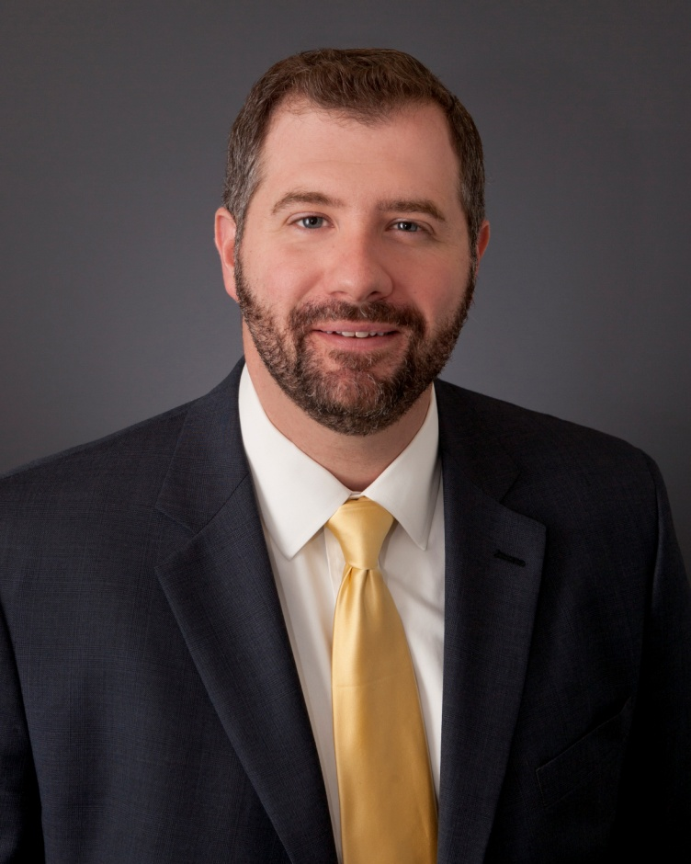
Why Did Ted Join?

Slide 8
Why Did Ted Join?
Saw 100’s of people fail – really began to feel disingenuous in my pitches.
There has to be a Better Model – Why can’t somewhat more traditional offices be run like teams were run at KW?
People are the most Important – Met Dan Giannetto, Jace Botti and all the people I have met since have continued to back up that theory.
Tools and Training – Wanted to go to a company that had great tools, systems, and training. I know its value to realtors who want to grow.

Slide 9
Why Did Ted Join?
Weichert is fully positioned to succeed.

Slide 10
The Task of Convincing Others to Join
It can be daunting overcoming the Keller Williams Model. Knowing how to understand an experienced recruits needs and be able to verbalize the differences between Weichert and Keller Williams are key.

Slide 11
Poll: What’s your greatest Challenge?
When it comes to recruiting KW agents, what’s your greatest challenge?
KW’s Cutting Edge Technology
KW’s “Culture”
KW’s Commission Structure/70% Split
KW’s Brand Image
Other (please write in the Q&A box your top challenge)

Slide 12
Remainder of Today’s Webinar
We’ll focus on the 70% lie
Before we talk about the numbers, it’s important to recognize this is a process.
You’re not discussing numbers or trying to structure the deal with a recruit until you’ve met, established rapport, built the relationship and really learned about the recruit’s needs, priorities and “hot buttons.”

Slide 13
Experienced Recruit Process
Contact
Appointment
Presentation
Next Step
ABRF
How many times do you talk on the phone before you gain agreement to meet?
How many times do you meet to build the relationship and learn about needs before you even discuss what Weichert has to offer?
HIRE!!
ABRF = Associate Benefit Request Form (does this make sense financially for the company and the recruit?)

Slide 14
Some tools to support the Process
Build the Relationship (build trust, learn about needs and priorities. Capture information about recruit.)
Share your Value (When you know the recruit is ready to learn more, share the value. Customize to the recruit’s “hot buttons”)
Help them Transition Here (Show them you have it all covered.)

Slide 15
Poll: Ready to talk numbers?
Contact
Appointment
Presentation
Next Step
ABRF
Are you, at this moment, ready with one or more KW agents to create an ABRF and structure a deal that will compete with what they currently have?
Yes
No
HIRE!!

Slide 16
If you’re not at this point . . .
You can’t really start talking numbers until you meet them a few times. Get appointments with recruits! Get to know them.
You can’t really start talking numbers until you’ve built the relationship, learned about their needs, priorities and hot buttons.
You can’t really start talking numbers until you’ve had the opportunity to share how Weichert is different and share your value and the company’s value.

Slide 17
Make it a Conversation
When the recruit shows real interest, share the value with the recruiting presentation and make it a conversation.
Use open-ended questions.
Turn to the pages that mean something to the recruit (e.g., “You told me that receiving more leads was something you’re most interested in talking about. Let me show you what we have for you . . .”

Slide 18
The 70% Misconception
KW Agent: “I don’t care about that. I don’t use any of those things you are asking me to pay for. I just want my 70%.”
YOU Say: “I understand. . . Let’s discuss the numbers then . . . “

Slide 19
The Numbers Conversation…
Contact
Appointment
Presentation
Next Step
ABRF
After you see they’re interested.
They like you. You like them . . .
How would the numbers work? You need to learn more from them . . .
HIRE!!

Slide 20
Example #1: Joe Agent
22 years old
Just finished real estate school
Considering Keller Williams because of the ‘high splits’ and ‘great training’
Has some family members/friends that might buy this year
1-2 other decent leads
Has very little money to start business with

Slide 21
Volume sold last year:
Current Split:
Current Franchise/Royalty Fee:
Current local tax payback/alternate fees:
How many transactions last year?
Was there a transaction per fee?
Where did most business come from?
Did that source have a cost?
What marketing/materials did company supply?
Materials/Resources we provide for you:
Did you get any company leads?
At what split?
How many company leads do you think we
would give you? At what split?
Do you have monthly fees? E&O fees? Others?
Are you reimbursed for marking or an assistant?
What can we do?
Do you use a desk or office at your brokerage?
Do they charge a fee?
How much did you pay for business cards,
signs, and sign placement?
Do you pay for your own CRM?
Have you seen WeichertPro?
It’s a Conversation.

Slide 22
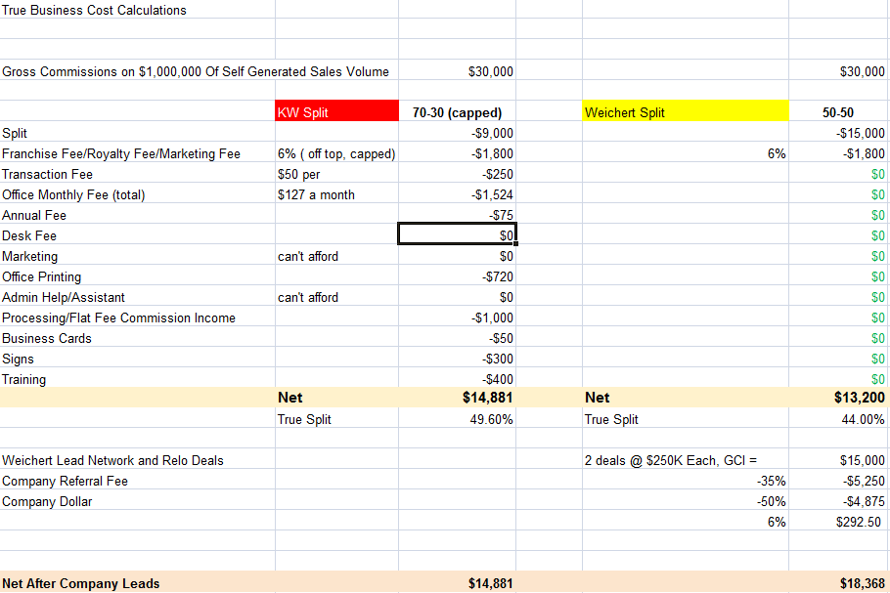

Slide 23
Any Questions or Comments so far?
Webinar Toolbar
Please write your questions in the Question and Answer box of the Webinar Toolbar now

Slide 24
Example #2: Jane Agent
Age 37
5th year in the business
Has been at Keller Williams since she started. Thinks the “traditional companies” take too much
Sold approximately 3.5-4 million in the last 12 months
Mostly based on personal network referrals, some open houses, and some past client referrals.
Does some mail (just listed, just sold, free home estimates, etc.)

Slide 25
Volume sold last year:
Current Split:
Current Franchise/Royalty Fee:
Current local tax payback/alternate fees:
How many transactions last year?
Was there a transaction per fee?
Where did most business come from?
Did that source have a cost?
What marketing/materials did company supply?
Materials/Resources we provide for you:
Did you get any company leads?
At what split?
How many company leads do you think we
would give you? At what split?
Do you have monthly fees? E&O fees? Others?
Are you reimbursed for marking or an assistant?
What can we do?
Do you use a desk or office at your brokerage?
Do they charge a fee?
How much did you pay for business cards,
signs, and sign placement?
Do you pay for your own CRM?
Have you seen WeichertPro?
It’s a Conversation.

Slide 26
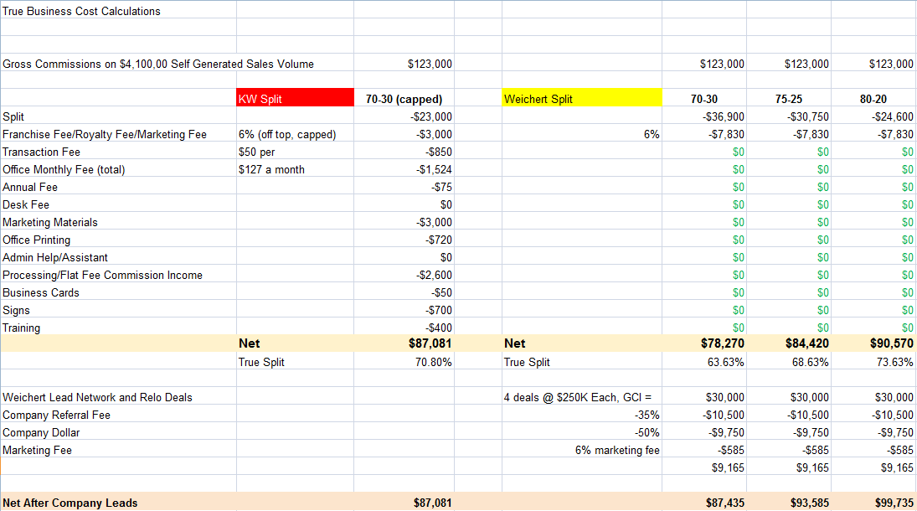

Slide 27
Any Questions or Comments so far?
Webinar Toolbar
Please write your questions in the Question and Answer box of the Webinar Toolbar now

Slide 28
Our Next Webinars
Monday November 2nd
Two times to choose: 10:00 a.m. or 2:00 p.m.
Topic: The Keller Williams Model vs. the Weichert Model and Structuring the Deal
Monday November 9th
Two times to choose: 10:00 a.m. or 2:00 p.m.
Topic: Your 60 Second Elevator Pitch, Your Value, and Using Capture to Recruit Experience Agents
Email us with other topics you’d like covered in these webinars.

Slide 29
Thank You For Your Time Today!

